Slide 1
Springboard Capstone Project
A look into Wikipedia (Also the place where the catchy phrase goes if I had one)

Slide 2

Introduction

Slide 3
Exploratory Data Analysis

Slide 4
Retrieving the data
Prior to analysis, data was retrieved from Wikipedia’s pageview dataset dumps. Wikipedia maintains these datasets on a daily basis and we can programmatically download these in bulk using the script in the “src” folder.
For incremental updates, we can utilize one of Wikipedia’s featured Python API client pageviewsapi. We can make api calls based on titles that can be found in the all titles data dump.

Slide 5
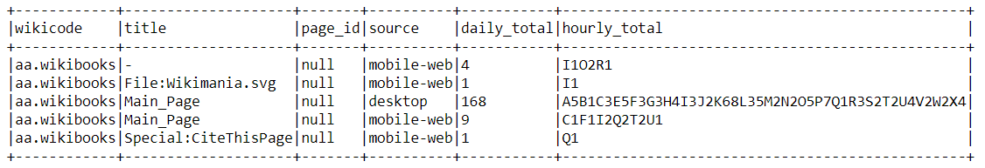
Transforming the data
For analysis, we looked at Wikipedia’s pageview dataset for 2021-01-01. I was only interested in articles from English Wikipedia, so the wikicode needed to be filtered and null values in page_id needed to be removed. The hourly_total column was also unusable at its current state.

Slide 6
Transforming the data
The dataset was transformed to two dataframes to be loaded as separate tables in the downstream database. The schema is shown in the next slide. In the final product, PySpark should load data from Azure Data Lake and store it in a MySQL database.

Slide 7
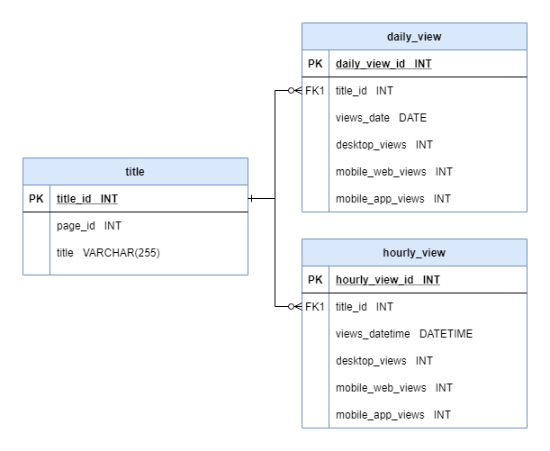
ERD

Slide 8
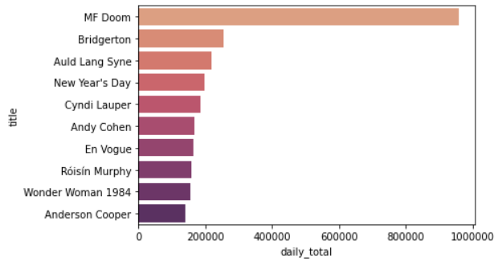
Quick Look Into the Data
1
Although masked rapper MF Doom died in Oct 2020, his spike in Wikipedia page views may have been due to a CNN article posted on 2021-01-01.
6
Talk show host rang in the New Year with Anderson Cooper.
7
R&B group that performed on NYE.
2
Popular Netflix series that released late Dec 2020.
8
Performed on BBC for NYE.
3
Poem and song to bid farewell to the previous year.
9
Movie released late Dec 2020.
4
New Year’s Day on 1/1!
5
Lauper had a poorly received NYE performance.
10
CNN anchor that had a NYE show with Andy Cohen.

